Slide 1
Python

Slide 2
Introduction
Python is a high-level, general-purpose, and very popular programming language.
It is used in web development, AI, Data Science and Machine Learning applications.
Used in Google, Facebook, Instagram, Dropbox, Uber… etc.
It was initially designed by Guido van Rossum in 1991 and developed by Python Software Foundation.
Python emphasizes code readability and simplicity, making it an excellent language for beginners and experienced developers.

Slide 3
Features:
Simple and Easy to Learn
Extensive Standard Library
Interpreted : code is executed line by line
Dynamic Typing : No need to declare the data type.
Strong Typing : data type of a variable is enforced at runtime.
Cross-Platform: run on different operating systems
Versatile : used for various purposes, including AI, DS, ML.

Slide 4
Module & PIP:
Module is a files containing Python code, which can include variables, functions, and classes.
They help organize code into reusable parts, making it easier to manage and maintain large projects.
PIP is the standard tool for installing Python packages and their dependencies in a secure manner.
Example:
pip install pyjokes
import pyjokes

Slide 5
Variable:
A variable is the name given to a memory location.
A value-holding Python variable is also known as an identifier.
Naming Rule:
The variable's first character must be an underscore or alphabet.
Every one of the characters might be a letter set of lower-case, capitalized, highlight, or digit.
White space and special characters (!, @, #, %, etc.) are not allowed in the identifier name.
Names of identifiers are case-sensitive;

Slide 6
Variable Declaration:
name = “Ram"
age = 20
marks = 92.67
print(name)
print(age)
print(marks)
a,b,c = 5,10,15
print a
print b
print c
Print(1, 2, 3, 4, 5, 6, 7, 8)
Del c

Slide 7
Local Variable: Global Variable:
x = 101
def mainFunction():
global x
print(x)
x = “Global Variable”
print(x)
mainFunction()
print(x)
def add() :
a = 20
b = 30
c = a + b
print("The sum is:", c)
add()

Slide 8
Tokens:
The tokens can be defined as a punctuator mark, reserved words, and each word in a statement.
The token is the smallest unit inside the given program.
There are following tokens in Python:
Keywords.
Identifiers.
Literals.
Operators.

Slide 9
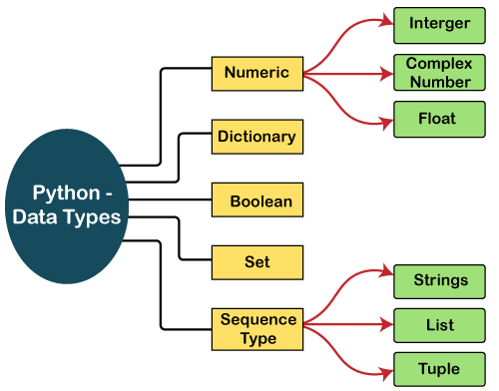
Data Types:
In Python its not necessary to specify datatype.
The Python interpreter will automatically interpret the variable’s datatype.
The type() function in Python returns the type of the passed variable.
Print(type(a))

Slide 10
Primary Datatypes:
Numbers: a = 10
Pointer numbers: pi = 3.14
Boolean: answer = false
String: name = “Luffy”
None: _empty = None

Slide 11
Type Casting:
Similar to type conversion, type casting is done when we want to specify a type on a variable.
Example:
a = “123”
b = int(a) # converting string to integer
print(type(a))
print(type(b))

Slide 12
Operator:
A symbol that used to perform some operations.
Types:
Arithmetic Operator
Assignment Operator
Relational Operator
Logical Operator
Identity operator
Membership operator

Slide 13
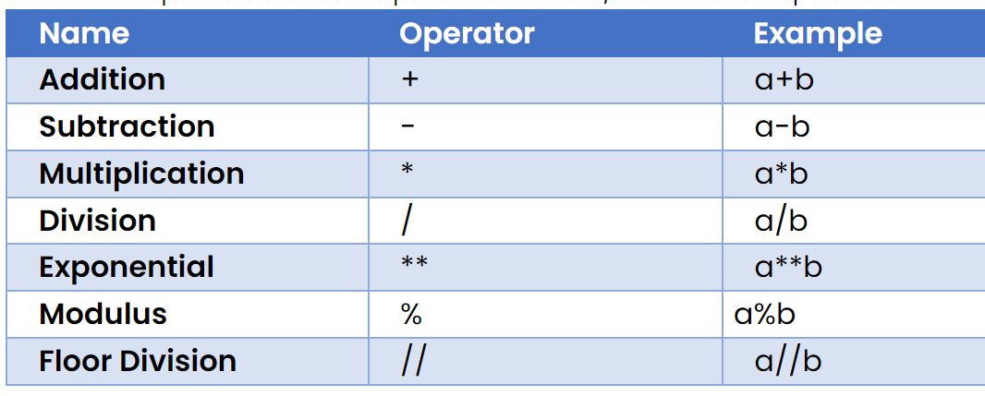
Arithmetic Operator:

Slide 14
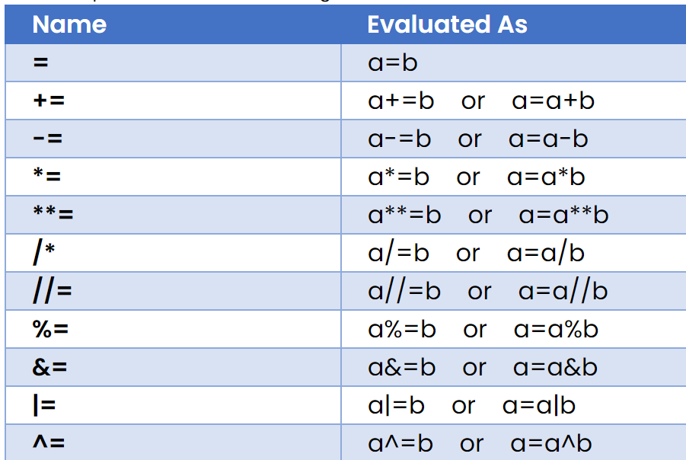
Assignment Operator

Slide 15
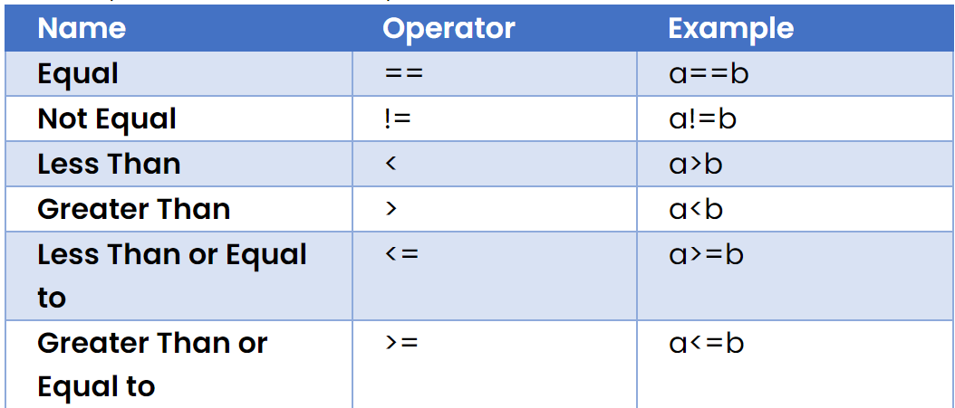
Relational operator

Slide 16
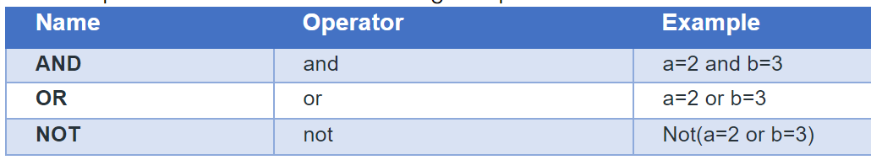
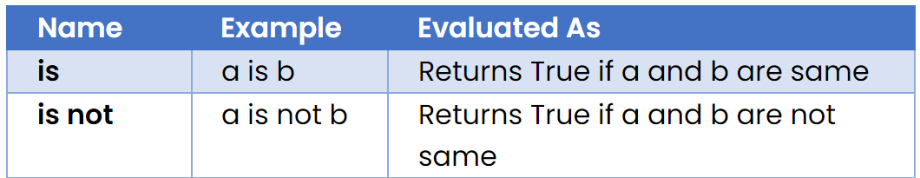
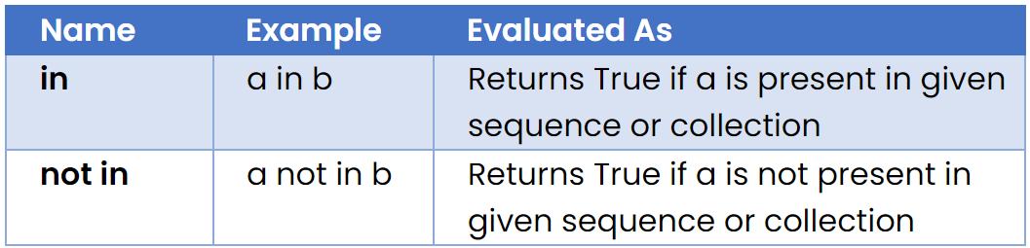
Logical, Identity & Membership

Slide 17
User Input:
In python we can use input() to get user input.
Default datatype of every input will be string.
we need to specify datatype when we are getting other datatype inputs from user like type casting.
Example:
age = int( input(“Enter a value: ”))
name = input(“Enter name: ” )
salary = float( input( “Enter salary: ” ))

Slide 18
Strings:
String is a sequence of characters enclosed with double quotes and its immutable data.
All the characters are stored based on index position.
Example:
name1 = ‘Zoro’
name2 = “Sanji”
name3 = ‘‘‘Luffy’’’
name1
Z O R O
0 1 2 3
Index positions

Slide 19
String Operations:
Name = “Strings”
Len(name) → To finding the length.
Name[1: 5] → slicing the string using index position
Name[-5:] → slicing using negative(reverse) order.
Name.upper() → Converting to uppercase.
Name.lower() → Coverting all char in lowercase
Name.replace(“S”, “T”) → Replacing the characters.

Slide 20
Name.strip() → Removing whitespace in front and back only.
Name.split(“ ”) → splits the words with space.
Name.title() → Converts every word first character will be capital.
Name.swapcases() → swap the cases of all charater.
Find() → To find the particular word or character.
Index() → It will give index position of particular char or word.
Isalnum() → It will check all char are only alphabets or numbers.
Startswith() → To check starting of a string
Endswith() → To check ending of a string.

Slide 21
Python List:
Lists are ordered collection of data items.
They store multiple items in a single variable.
Lists are changeable meaning we can alter them after creation.
Example:
list1 = [1,2,2,3,5,4,6]
list2 = ["Red", "Green", "Blue"]
print(list1)
print(list2)

Slide 22
List methods:
Append() → To add a data into the list.
Insert(index, value) → adding data with index positions.
Extend() → adds an entire list or any other collection datatype.
Pop() → It will remove top(fisrt) data in list.
Remove() → it will remove specific data in list.
Clear() → clear the items and Empty the list.
Sort() → arrange the data in ascending order.(sort(reverse=true))
Count() → conts the data length of an list.
Copy() → copy all the list item and we can store it in other list.

Slide 23
Python Tuples
Tuples are ordered collection of data items.
They store multiple items in a single variable.
Tuples are unchangeable meaning we can not alter them after creation.
We can add one tuple in another tuple using + operator.
Example:
tup1 = ( 1, ‘a’, 3.25, 4, 5 )
tup2 = ( “Apple”, “Banana”, “Orange” )
print( tup1, tup2 )

Slide 24
Manipulating Tuples:
Tuples are immutable, hence if you want to manipulate then first you must convert the tuple to a list.
Example:
countries = ("Spain", "Italy", "India", "England", "Germany")
temp = list(countries)
temp.append("Russia") #add item
temp.pop(3) #remove item
countries = tuple(temp)
print(countries)

Slide 25
Unpack tuples:
Unpacking is the process of assigning the tuple items as values to variables.
You can add an * to one of the variables and depending upon the position of variable and number of items, python matches variables to values and assigns it to the variables.
Example:
info = ("Marcus", 20, "MIT")
(name, age, university) = info
fauna = ("cat", "dog", "horse", "parrot", "salmon")
(*animals, bird, fish) = fauna

Slide 26
Python set:
Sets are unordered collection of data items.
Sets are unchangeable, meaning you cannot change items of the set once created.
Sets do not contain duplicate items.
Example:
info = {"Carla", 19, False, 5.9, 19}
print(info)

Slide 27
Set operations:
Add() → To add item in set.
Update() → To add another set or collection data in existing set.
Remove() → delete a particular item from set.
Discard() → delete the item if it is present if not then doesn’t give error.
Union() → to combine two set as one.
isdisjoint() → checks if items of given set are present in another set
issuperset() → checks if all the items of a particular set are present in the original(super) set. [issubset() → checks sub set]

Slide 28
Join sets:
Intersection() → prints only items that are similar to both the sets. returns a new set.
Intersection_update() → does the same but updates into the existing set from another set.
symmetric_difference() → prints only items that are not similar to both the sets and returns a new set.
symmetric_difference_update() → same and updates into the existing set from another set.
difference() and difference_update() methods prints only items that are only present in the original set and not in both the sets.

Slide 29
Python Dictionaries:
Dictionaries are ordered collection of data items.
Dictionaries items are key-value pairs that are separated by commas and enclosed within curly brackets {}.
Example:
info = {'name':'Karan', 'age':19, 'eligible':True}
print(info)
Methods:
infor.values() → only prints values.
info.keys() → only key prints.
info.items() → key-vaue pair prints.

Slide 30
Dictionary methods:
Info[“key”] = value → adding item in dictionary.
Update({ key: value}) → adding item using update.
Clear() → deleting all items in dictionary.
Pop(key) → delete the item using key.
Popitem() → delete the last key-value pair from dictionary.
Del info[key] → delete the data of key passed.
Del info → delete the entire dictionary.
Copy() → copy all the data from dictionary.

Slide 31
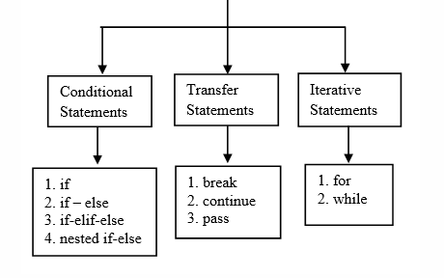
Conditional Statements

Slide 32
if statements
If – else:
Syntax:
if(condition):
#statement
else:
#statement
Else – if ladder:
Syntax:
if(condition1):
#statement
elif(condition2):
#statement
else:
#statement
Nested If :
Syntax:
if(condition1):
if(condition2):
#statement
else:
#statement

Slide 33
Looping:
For loops can iterate over a sequence(list, set…etc) of iterable objects in python.
Syntax:
for i in range(1,10):
print(i)
while loops execute statements while the condition is True.
As soon as the condition becomes False, the interpreter comes out of the while loop.
Syntax:
while(condition):
#statement

Slide 34
Control statement
Pass:
pass statement acts as a placeholder for future code.
Continue:
It is used in loops to end the current iteration and continue the next iteration of the loop.
Break:
It is used to bring the interpreter out of the loop and into the main body of the program.

Slide 35
Function:
A function is a block of code that performs a specific task whenever it is called.
It make the program flow organized and neat.
Two types:
built-in functions:
These functions are defined and pre-coded in python.
user-defined functions:
We can create functions to perform specific tasks as per our needs

Slide 36
Function Arguments:
There are four types of arguments that we can provide in a function:
Default Arguments:
While defining a function def name(name = “Sanam")
Keyword Arguments:
name(key = value) while calling the function.
Required Arguments:
Passing parameters to arguments with exact values.
Variable-length Arguments:
Passing more than one argument by its length Using *.

Slide 37
Anonymous Functions:
The lambda keyword can define anonymous, single-output functions.
Lambda function is a function is without a name.
Arguments can be accepted in any number by lambda expressions;
Good for performing short operations/data manipulations.
Using the lambda function can sometime reduce the readability of code.
Example:
lambda [argument1 [,argument2... .argumentn]] : expression

Slide 38
Oops in python
Object Oriented Programming is a methodology to write a code.
This concept focuses on using reusable code.
We will create classes and objects to solve problems.
A class is a blueprint or a template for creating objects.
object is an instance or a copy of the class with actual values.
Example:
class name: # class creation
name = “Sanam”
obj = name() # Object creation

Slide 39
__init__ method:
The __init__ method is used to initialize the object’s state and contains statements that are executed at the time of object creation.
We can also modify and delete objects and their properties.
Init method is also considered as a default constructor.
Self Parameter:
The self parameter is the first parameter of any function present in the class.
It can be of different name but this parameter is must while defining any function into class.
It is used to access other data members of the class.

Slide 40
Inheritance:
Inheritance is an important aspect of the object-oriented paradigm.
It provides code reusability to the program we can use an existing class to create a new class instead of creating it from scratch.
A class can inherit multiple classes by mentioning all of them inside the bracket.
Syntax:
class Animal: #base class
#Statements
class Dog(Animal): #child class Dog inherits Animal

Slide 41
Types of Inheritance:
Single Inheritance : inheriting only one parent class
Multiple Inheritance : child class inherits from multiple parent classes
Multilevel Inheritance: child and grandchild relationship
Hierarchy Inheritance : More than one derived class can be created from a single base.
Hybrid Inheritance : combines more than one form of inheritance

Slide 42
Polymorphism:
Polymorphism simply means having many forms.
We can achieve polymorphism using these methods…
Duck Typing : If class object have that method then it will work.
Method Overloading : Multiple methods having same name.
Method Overriding : Same name methods in different classes.
Operator Overloading : It provide extended meaning beyond their predefined operational meaning

Slide 43
Built-in or Magic function
+ → __add__(self, other)
- → __sub__(self, other)
* → __mul__(self, other)
/ → __truediv__(self, other)
// → __floordiv__(self, other)
% → __mod__(self, other)
** → __pow__(self, other)
+= → __IADD__(SELF, OTHER)
-= → __ISUB__(SELF, OTHER)
< → __LT__(SELF, OTHER)
> → __GT__(SELF, OTHER)
== → __EQ__(SELF, OTHER)
>= → __GE__(SELF, OTHER)
& → __and__(self, other)

Slide 44
Exception handling
Exception handling in Python refers to managing runtime errors that may occur during the execution of a program.
An exception is an event, which occurs during the execution of a program that disrupts the normal flow of the program's instructions.
These Exceptions will be handled using Try and Except blocks.
We can create or pass an Exception through raise keyword.
Assertions are commonly used at the beginning of a function to inspect for valid input.

Slide 45
Date & time:
Python provides the datetime module work with real dates and times.
In Python, the date is not a data type, but we can work with the date objects by importing the module named with datetime, time, and calendar.
Date, time, datetme, timezone these all are some of the classes present in datetime module.

Slide 46
File Handling
File handling in Python involves interacting with files on your computer to read data from them or write data to them.
Python provides several built-in functions and methods for creating, opening, reading, writing, and closing files.
Opening a File in Python:
file = open("filename", "mode")
Mode:
r – read, rb – read binary
w – write, wb – write binary
a – append, r+ - read & write

Slide 47
END

